Slide 1

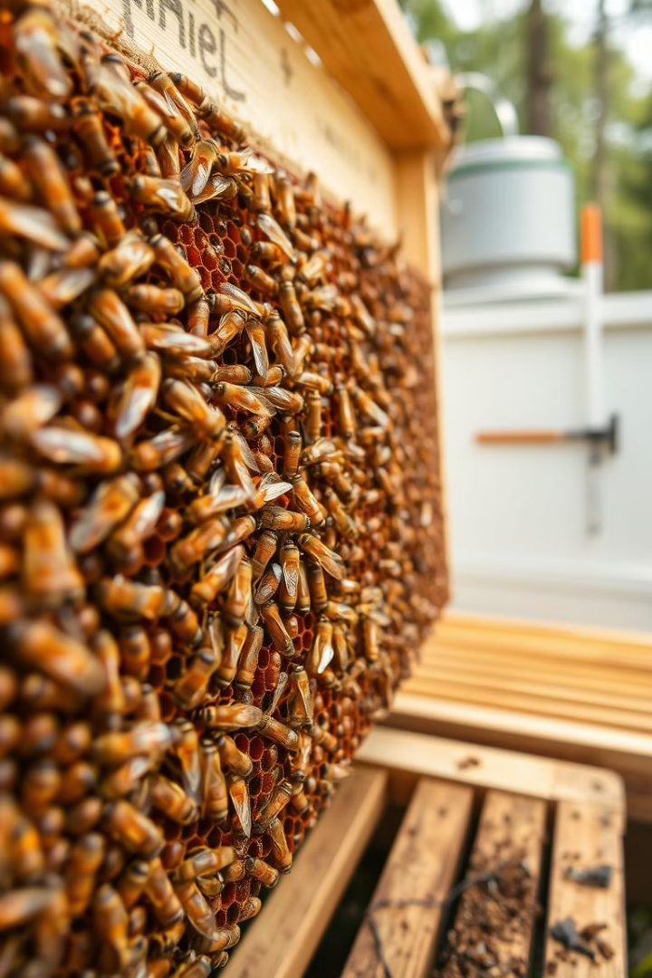


Preventing Mold Growth in Beehives- phase B
Presenters: Tamer Amer , Mbada Shehady
Supervisor: Dr.Naomi Unkelos-Shpigel
Project Code:
25-1-D-11

Slide 2
Road Map
Our Project
1
2
Current State
WorkFlow
3
4
Architcture
Flow Chart
5
6
Testing
FR & NFR
7
8
Challenges
SUS Questionnaire
9
2

Slide 3
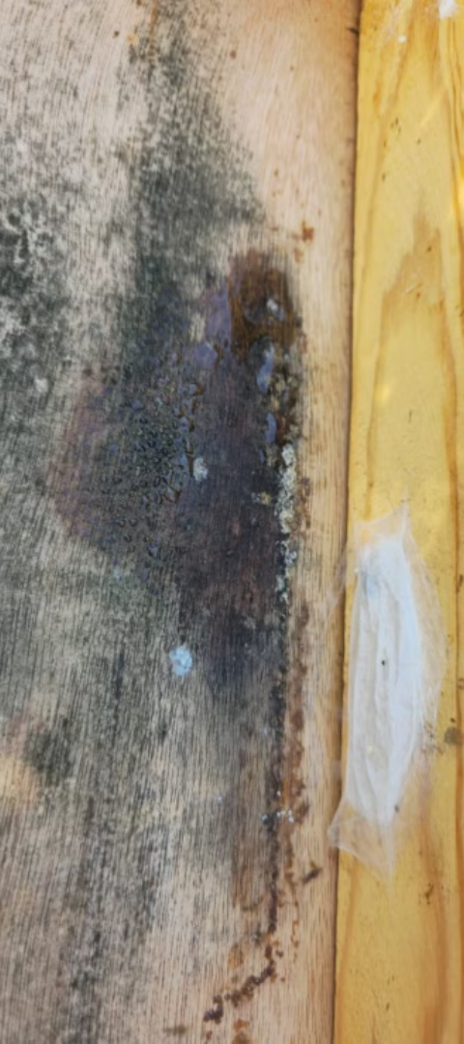
Our Project
1
Weather changes
2
Health Impact
High humidity in winter promotes mold growth (Fernandes et al., 2024)
Mold affects the quality of stored honey that we consume
Colony Collapse
4
Reduce Productivity
3
Persistent mold makes hives uninhabitable for bees (Zeaiter & Myerscough, 2020)
Bees expend more energy removing moldy combs (Becchimanzi & Nicoletti, 2022)
3

Slide 4
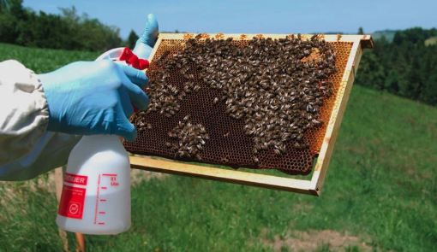
Current State:
1. Environmental management to direct antifungal interventions (Zeaiter & Myerscough, 2020)
2. Materials insulation for hives (Floris et al., 2020)
3. Manual checks and basic controls using antifungal sprays
4

Slide 5




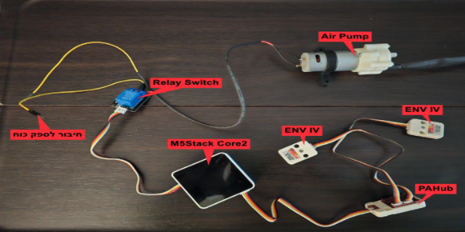
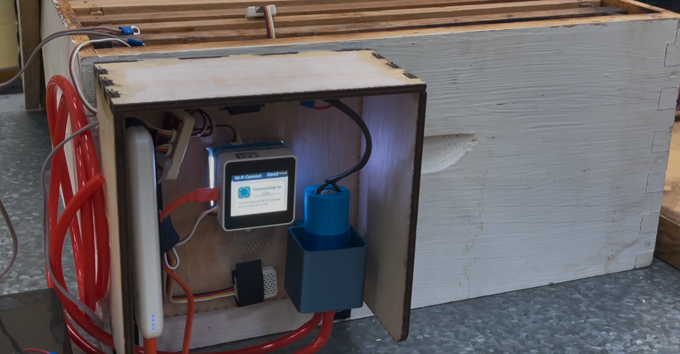
Objectives
Sensor-Based Mold Prevention
Real-Time Monitoring
Data-Driven Insights
Colony Health Optimization
Provide beekeepers with actionable insights through data analysis and visualization
Enhance colony health and productivity with predictive mold prevention strategies
Prevent mold with sensor-based temperature and humidity control
IoT sensors for real-time hive monitoring
5

Slide 6
WorkFlow
1.7.2025
Production and Getting beekeepers reviews on the system
19.3.2025
Zoom meeting to discuss about the phase 2 steps
25.6.2025
Building the website with all the integrations needed
21.4.2025
Preparing all the logistics and sensors that we will use
29.6.2025
Testing the whole system functionalities
6

Slide 7

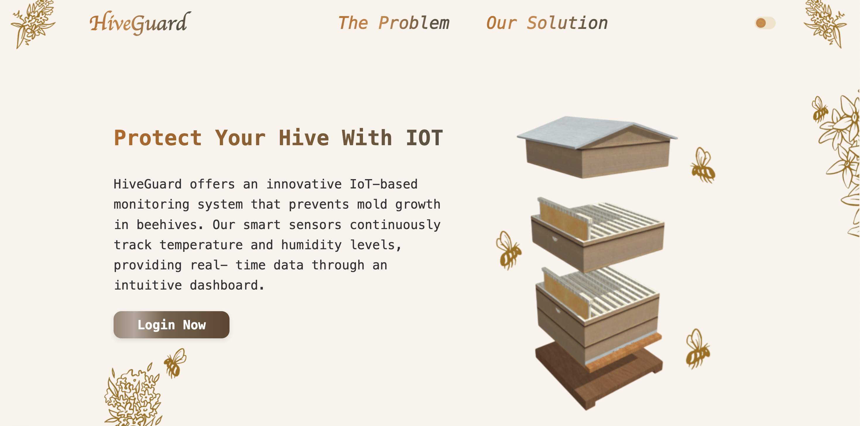
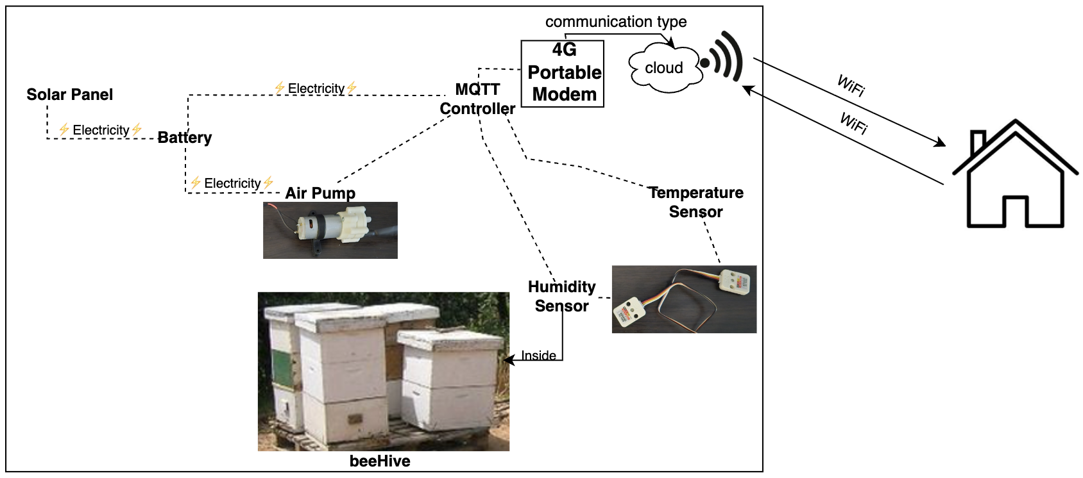
Architecture
System Access From Everywhere
7

Slide 8
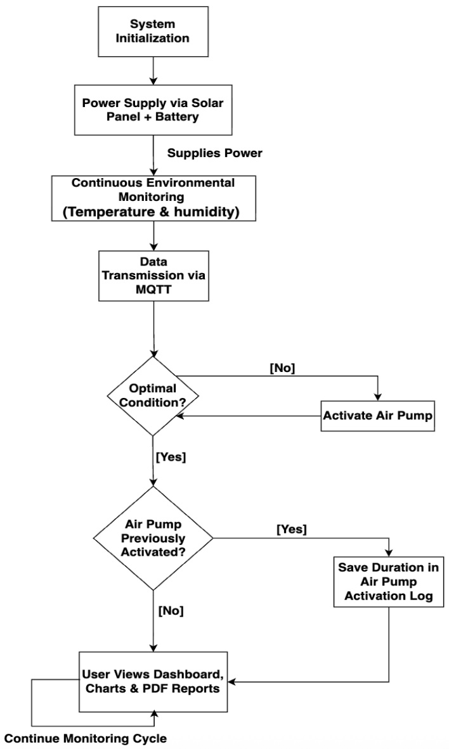
Flow Chart
Threshold-based logic reacts to hive changes in real time.
Optimal range: 28–35 °C and 50–60% humidity.
Sensors send data via MQTT topics.
8

Slide 9
TESTING
Functioal Testing | Non-Functioal Testing
Login & Registration: Login errors show correct messages Successful login/sign-up works | Recovery Tests: Data remained saved after sudden shutdowns, logouts, or crashes.
Beehive Management: Hives can be added and managed No sensor → system warns “No data received” | Reliability Tests: System handled missing/corrupted sensor data without crashing.
Hive Details Page: Real-time data updates correctly Air pump logs are saved PDF reports sent to Telegram Historical graphs display past data | Performance Tests: Data updated in real time via MQTT with no noticeable delays.
9

Slide 10
Functional & Non-Functional Requirements
FR:
NFR:
No. | Requirement
1 | The system provides recommendations for maintaining optimal hive conditions and preventing mold growth.
2 | The system generates alerts when environmental conditions exceed predefined thresholds for mold risk.
3 | The system offers a real-time data dashboard for beekeepers to view live sensor readings.
4 | The system allows users to generate PDF reports of hive conditions
No. | Requirement | Type
1 | The system interface is user-friendly, allowing beekeepers to easily access data, manage hives, and generate reports with minimal training. | Usability
2 | The system processes sensor data in real time and triggers alerts within a few seconds of detecting abnormal conditions. | Efficiency
3 | The system was built with modular architecture, enabling independent development, testing, and integration of components. | Modularity
4 | The system handles large volumes of sensor data reliably and maintains fast response times | Performance
10

Slide 11

Challenges
Hardware integration of sensors, pump, M5Stack, solar, and battery
Reliable real-time data transmission with MQTT
Learning and debugging logic in flow.m5stack.com
11

Slide 12
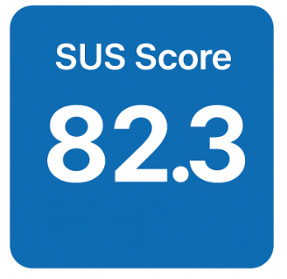
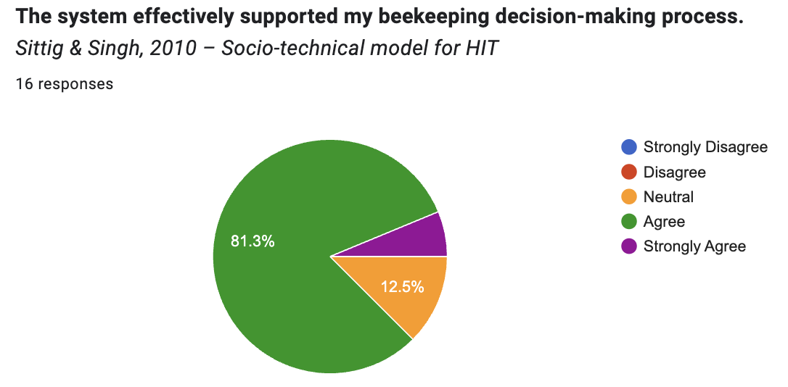
SUS Questionnaire:
Users showed high satisfaction, with a strong SUS score The system saves time by reducing physical inspections
The interface is intuitive and works smoothly on desktop
Improvements:
Better mobile chart visibility
multi-language support
location mapping
Users Evaluation
12

Slide 13
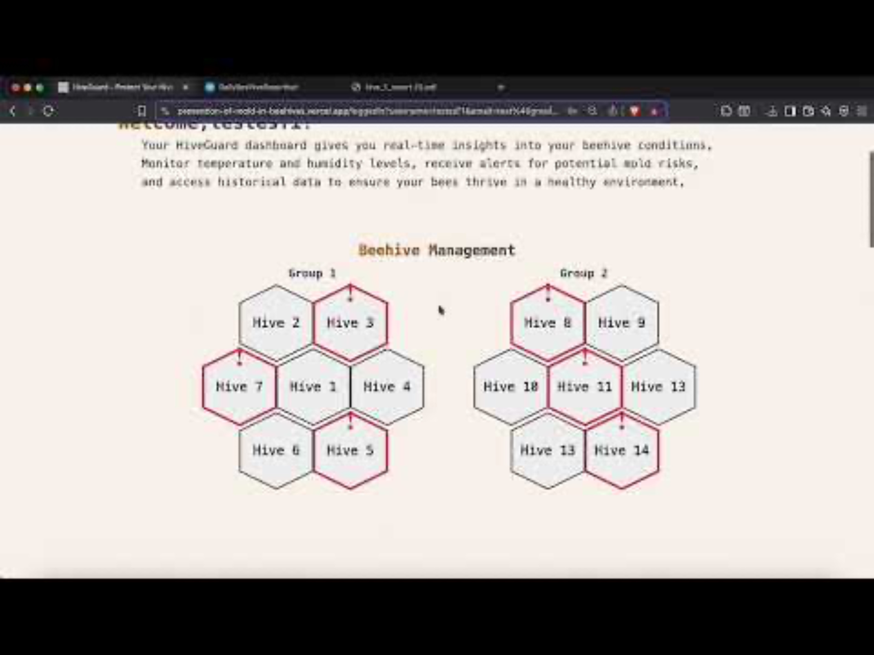
13

Slide 14

Thanks For Listening
Any Questions

